Slide 1
The Discrete Fourier Transform
Chapter-8
Dr. Ahmad Salman
Content and Figures are from Discrete-Time Signal Processing, 2e by Oppenheim, Shafer, and Buck, ©1999-2000 Prentice Hall Inc.

Slide 2


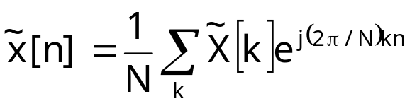
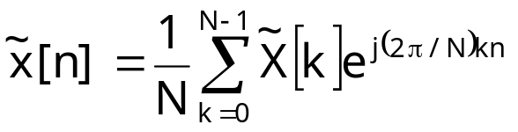
Discrete Fourier Series
Given a periodic sequence with period N so that
The Fourier series representation can be written as
The Fourier series representation of continuous-time periodic signals require infinite many complex exponentials
Note that for discrete-time periodic signals we have
Due to the periodicity of the complex exponential, we only need N exponentials for discrete time Fourier series

Slide 3
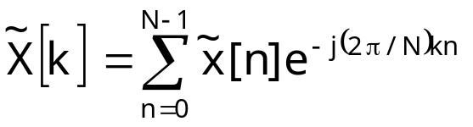

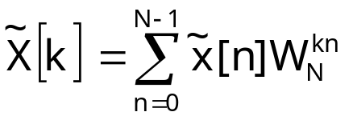
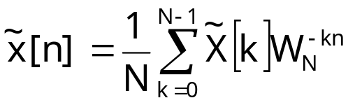
Discrete Fourier Series Pair
A periodic sequence in terms of Fourier series coefficients
The Fourier series coefficients can be obtained via (Proof !)
For convenience we sometimes use
Analysis equation
Synthesis equation

Slide 4
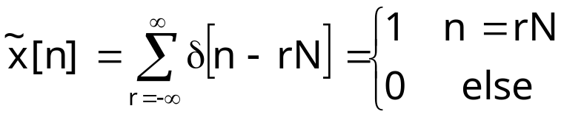
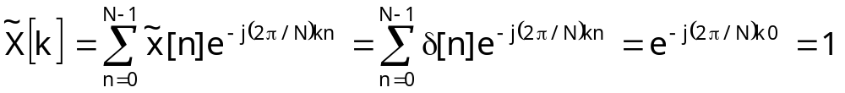
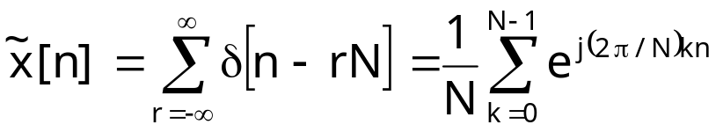
Example 1
DFS of a periodic impulse train
Since the period of the signal is N
We can represent the signal with the DFS coefficients as

Slide 5
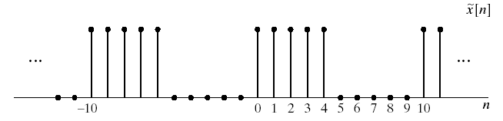
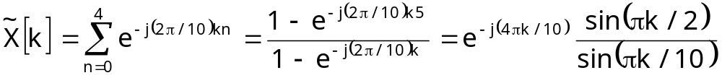
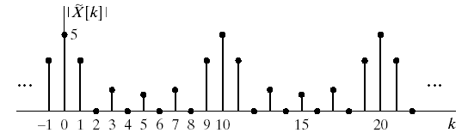
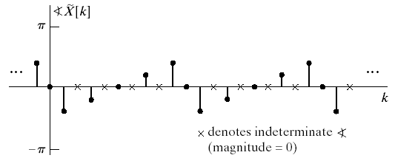
Example 2
DFS of an periodic rectangular pulse train
The DFS coefficients

Slide 6
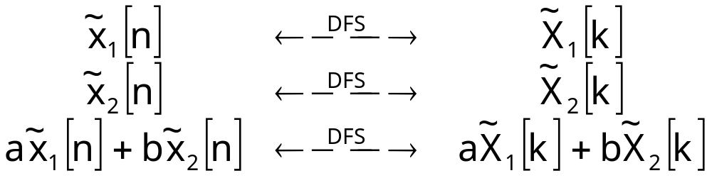
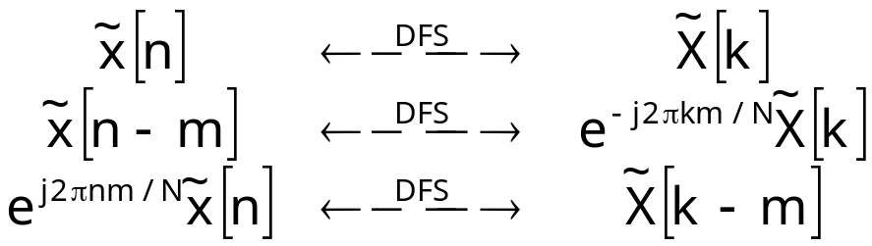
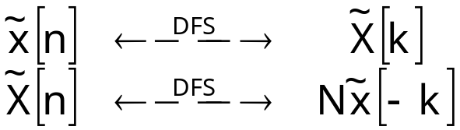
Properties of DFS
Linearity
Shift of a Sequence
Duality

Slide 7
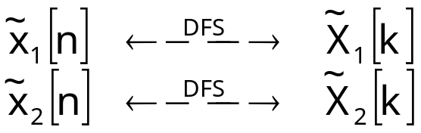

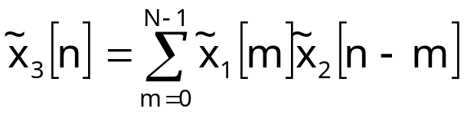
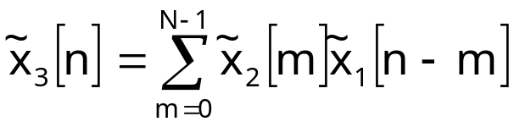
Periodic Convolution
Take two periodic sequences
Let’s form the product
The periodic sequence with given DFS can be written as
Periodic convolution is commutative

Slide 8
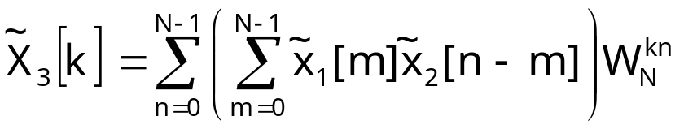
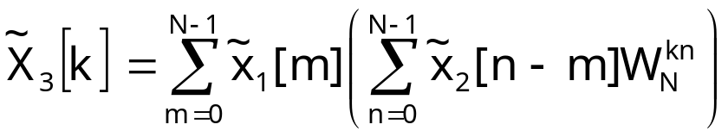
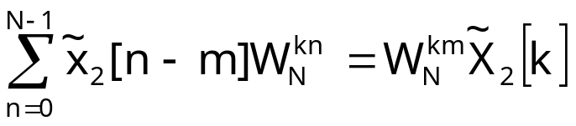
Periodic Convolution Cont’d
Substitute periodic convolution into the DFS equation
Interchange summations
The inner sum is the DFS of shifted sequence
Substituting

Slide 9
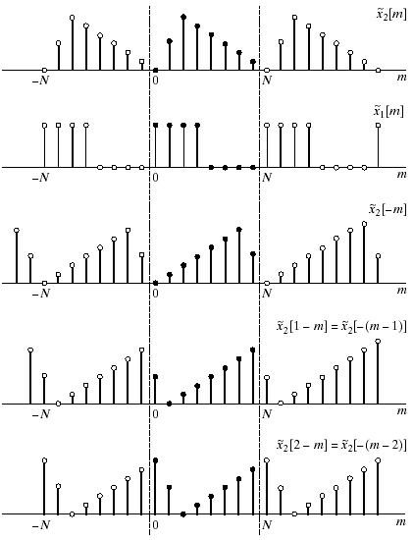
Graphical Periodic Convolution

Slide 10
Graphical Periodic Convolution
http://doctord.dyndns.org/courses/BEI/EE301/EE235/demos/cir_conv.html

Slide 11
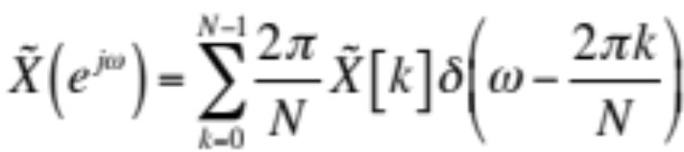
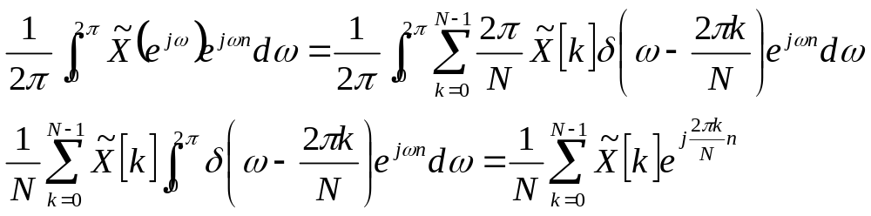
The Fourier Transform of Periodic Signals
Periodic sequences are not absolute or square summable
  Hence they don’t have a Fourier Transform
We can represent them as sums of complex exponentials: DFS
We can combine DFS and Fourier transform
Fourier transform of periodic sequences
  Periodic impulse train with values proportional to DFS coefficients
  This is periodic with 2π since DFS is periodic
The inverse transform can be written as

Slide 12
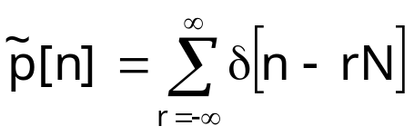

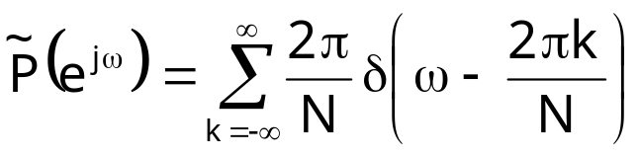
Example
Consider the periodic impulse train
The DFS was calculated previously to be
Therefore the Fourier transform is

Slide 13
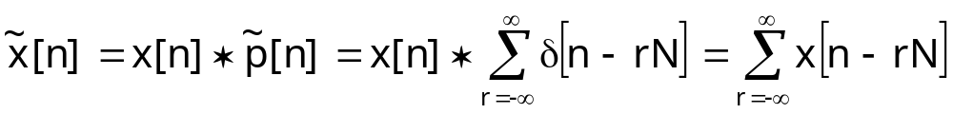
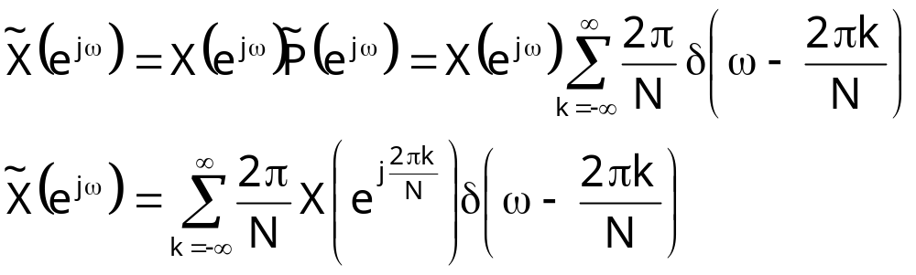
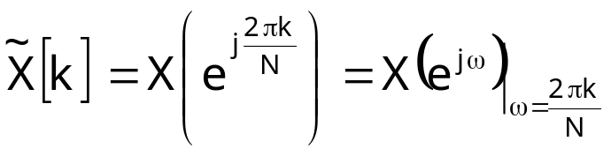
Relation between Finite-length and Periodic Signals
Consider finite length signal x[n] spanning from 0 to N-1
Convolve with periodic impulse train
The Fourier transform of the periodic sequence is
This implies that
DFS coefficients of a periodic signal can be thought as equally spaced samples of the Fourier transform of one period

Slide 14
Relation between Finite-length and Periodic Signals
Consider finite length signal x[n] spanning from 0 to N-1
Convolve with periodic impulse train
The Fourier transform of the periodic sequence is
This implies that
DFS coefficients of a periodic signal can be thought as equally spaced samples of the Fourier transform of one period

Slide 15
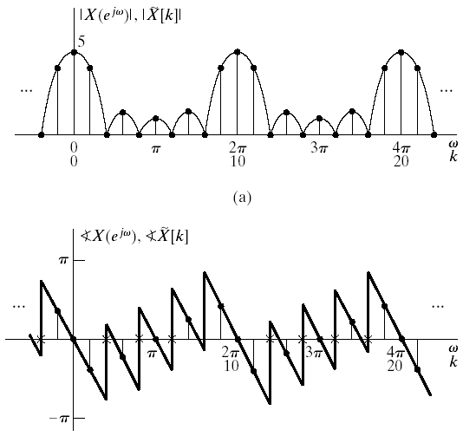
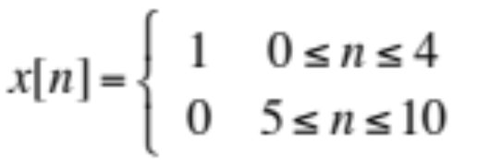
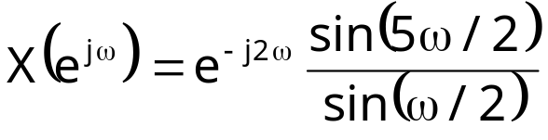
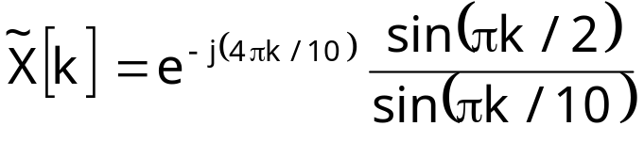
Example
Consider the following sequence
The Fourier transform
The DFS coefficients

